Slide 1
Project:
Digital Clock using Arduino UNO
Name :Piyush Mishra
Admission No. :21JE0654

Slide 2
Aim
To design a digital clock showing day, date in DD/MM/YYYY and time in HH:MM:SS formats.

Slide 3
Components required
1.Arduino UNO board
2.RTC DS1307 module
3.Jumping wires ( 4- male to female)
4. USB type-A to type-B
5.Lithium Battery 3V

Slide 4
RTC DS1307 module
RTC is an electronic device in the form of an Integrated Chip (IC) available in various packaging options. The purpose of an RTC or a real-time clock is to provide precise time and date which can be used for various applications. We have used DS1307 module. The RTC module is ideal in any time-critical applications like attendance systems, digital cameras, automated sprinkler systems, or a time and calendar display.

Slide 5
Procedure
We connect the GND, VCC, SDA and SCL pins of the RTC module to the GND, 5V, SDA and SCL pins of the arduino board.
We use the RTC module to get the date and time values.
We store the name of the days in an array.
We present the date and time values on the serial monitor and invoke the names of the days accordingly.
We successfully output the day and time values on the serial monitor.

Slide 6
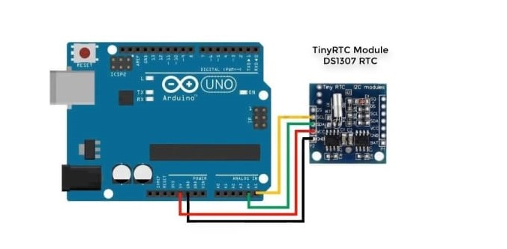
Circuit Diagram

Slide 7
THANK YOU!

